Slide 1
Lahore Resolution and the subsequent incidents leading to the partition of India 1947

Slide 2
Political environment before lahore resolution
Due to separate electorate, Hindu-Muslim divide widened
All India Muslim League emerged as a mass political organization emphasizing for Muslim unity
Leaders like Khwaja Nazimuddin and Hussain Shahid Suhrawardy – emerged as two prominent leaders not only in Bengal but also of the AIML;
Indian politics entered into the phase of power politics
In this backdrop, Lahore resolution was passed on March 23, 1940.

Slide 3
The Lahore resolution
A K Fazlul Huq introduced the resolution of the Conference;
He was the founder of the Krishak Praja Party in 1936.
But left KPP over the question of abolition of Zamindari (Landlordism) and joined Muslim League in 1937.
It was a three day 22-24 March, 1940 general session of the AIML.

Slide 4
The Lahore resolution
“That geographically contiguous units are demarcated regions which should be constituted, with such territorial readjustments as may be necessary that the areas in which the Muslims are numerically in a majority as in the North Western and Eastern Zones of (British) India should be grouped to constitute ‘independent states’ in which the constituent units should be autonomous and sovereign.”

Slide 5
Implications
For the first time, advocated for separate autonomous and sovereign states for the Muslims of India, although Choudhury Rahmat Ali proposed the Idea of Pakistan in his ‘Pakistan Declaration’ in 1933. According to Ali, Pakistan encompasses: Punjab, NW Frontier Province (Afghan Provice), Kashmir, Sindh, and Baluchistan
This resolution rejuvenated the Muslim League and appear to represent the wishes of the Muslims of Indian-Subcontinent
Raised the hopes of the Muslims for separate states, especially the intelligentsia:
Satisfying their cravings for power; and
Influence free from the Congress
Fazlul Hug supported the Lahore resolution as it advocated provincial autonomy within a Federation of Muslim states.

Slide 6
Aftermath of the lahore resolution
In 1944 Jinnah announced for a single Muslim state, Pakistan, composed of six provinces: Punjab, NWFP, Sindh, Bengal and Assam, Baluchistan. Assam was included as a bargaining chip with the Indians and the British.
1n 1946, a Muslim League meeting in New Delhi adopted a resolution demanding a United Pakistan. It superseded Lahore Resolution.
Soon after WWII, British Government announced the Wavell Plan for India on 14 June 1945.
The Plan proposed for elections to both central and provincial legislatures; and
Also for the installation of a constitution making body.

Slide 7
Elections of 1945-1946
According to the Wavell Plan, General Elections were held in December 1945 and Provincial Elections were held in January 1946. Pakistan demand of the ML was put to test.
Muslim League won all the Muslim seats allocated to the central assembly. Total no. of seats were 102. Elections held as per Govt. of India Act 1919 since 1935 could not be implemented due to non-participation by the Princely states.
In provincial legislatures ML won 446 out of 495 Muslim seats.
Total seats in Provincial Assemblies 1585, INC won 923

Slide 8
Overall Muslim League Performance^{[23]}
Legislative Assemblies
Province | Congress | Muslim League | Other parties | Independents | Total
Assam | 58 | 31 | Europeans 9 Others 3 | 7 | 108
Bengal | 86 | 113 | Europeans 25 Others 12 | 14 | 250
Bihar | 98 | 34 | 8 | 12 | 152
Bombay | 125 | 30 | 2 | 18 | 175
Central Provinces | 92 | 13 |  | 7 | 112
Madras | 163 | 28 | Communist Party 2 | 22 | 215
North West Frontier Province | 30 | 17 | 2 | 1 | 50
Orissa | 47 | 4 |  | 9 | 60
Punjab | 51 | 73 | Akalis 22 Unionist Party 20 Majlis-e-Ahrar-e-Islam 2 | 7 | 175
Sind | 18 | 27 | 10 | 4 | 60
United Provinces | 153 | 54 | 7 | 14 | 228
Total | 923 | 425 | 123 | 114 | 1585
Province | Muslim Seats | Muslim League | % Of Muslim Seats won by Muslim League
Assam | 34 | 31 | 91%
Bengal | 119 | 113 | 95%
Bihar | 40 | 34 | 85%
Bombay | 30 | 30 | 100%
Central Provinces | 14 | 13 | 93%
Madras | 29 | 29 | 100%
North West Frontier Province | 36 | 17 | 47%
Orissa | 4 | 4 | 100%
Punjab | 86 | 74 | 86%
Sind | 34 | 28 | 82%
United Provinces | 66 | 54 | 82%
Total | 492 | 429 | 87%

Slide 9
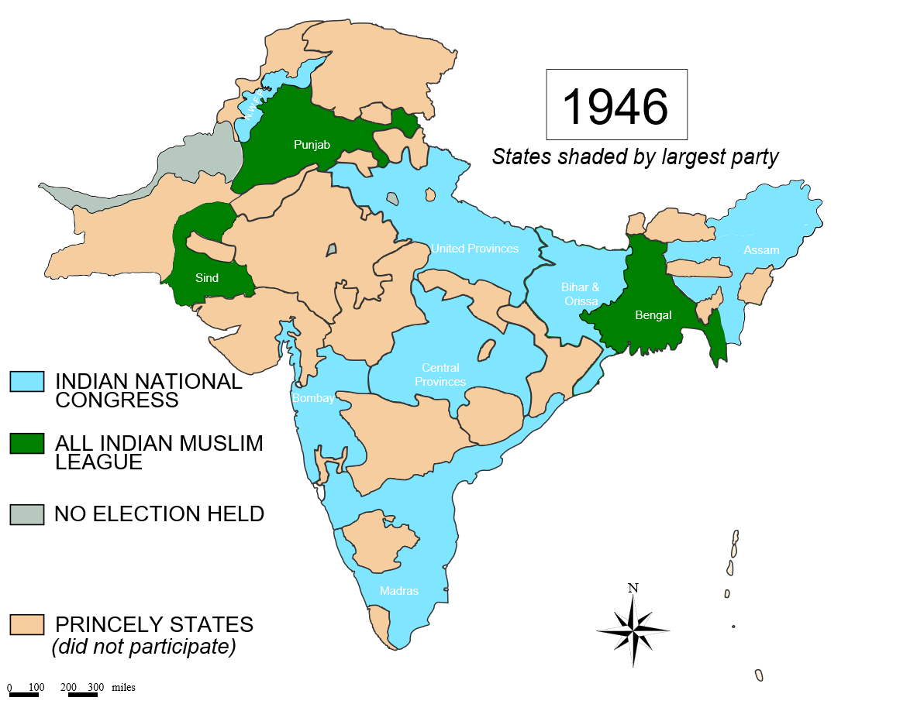

Slide 10
The Cabinet Mission Plan of 1946
A Cabinet Mission consisting of Lord Pethick Lawrence, Sir Stafford Cripps and Albert Alexander arrived in India soon after the election.
In May 1946, they announced their constitutional plan.
Proposed for a Confederation of India consisting of three groups: Hindus, Muslims and the Princely States.
The League grudgingly accepted the plan in the hope that it would solve the constitutional crisis.
Congress accepted the plan but declined to participate in the proposed interim government.
ML interpreted Congress’ stand as a rejection of the Plan.
ML declared Direct Action plan in August 1946.
The Cabinet Mission became a failure.

Slide 11
The riots and the interim government
Communal riots broke out first in Calcutta, Bengali-Muslim were killed.
Reprisals took place in October in Noakhali and Comilla in East Bengal.
The Bihar slaughter began in reaction to East Bengal on 30 October 1946.
This were followed by riots in United Provinces, Punjab and NWFP.
Both Congress and ML joined the interim government on 24th August and 25th October respectively.
Attlee’s government sent Lord Mountbatten as the new Governor General of India.

Slide 12
The Mountbatten Plan
On June 3, 1947, Mountbatten announced his partition plan.
Proposed two constituent assemblies for India and Pakistan to take over powers from the British government.
Bengal and Punjab were to be partitioned.
Princely states to join India and Pakistan on the basis of religion.
Pakistan became independent on 14 August 1947 and India on 15 August 1947.
Hence, Pakistan was created with two provinces separated by one thousand miles of Indian territory.

Slide 13
Assessment of the Partition
Positive
End of British Colonialism and independence of India and Pakistan
Creation of a new State of Pakistan
Negative
Hindus and Muslims of the Indian Subcontinent were divided.
Sowed the seeds of communal disharmony.
Borders remain disputed
Hasty and rash process created protracted disputes.
Commenting on the Partition Patrick French wrote,
“ India’s journey to independence …remains a contentious and hugely sensitive area of history. In Britain, it is viewed as an embarrassment, in Bangladesh as a betrayal, in India as a mixed blessing, and in Pakistan as a matter too tender even to be serious discussed”.

